Slide 1

Introduction
Instructor’s Name

Slide 2
Technology impacts
The way we THINK
The way we CONNECT
The way we CONSUME

Slide 3


As computers increasingly become part of our daily lives, it is difficult to imagine any career that does not use computers
… in some way.

Slide 4
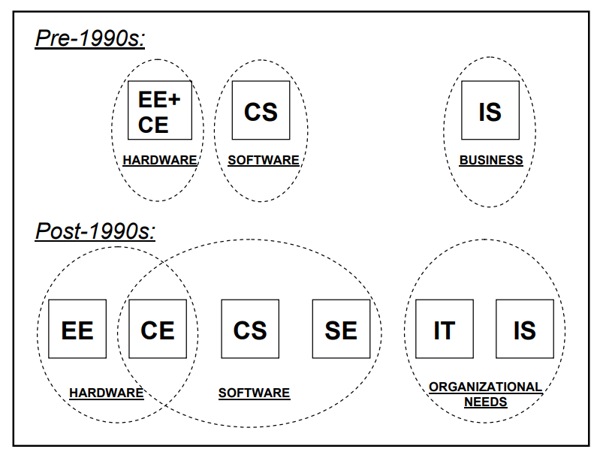

Slide 5
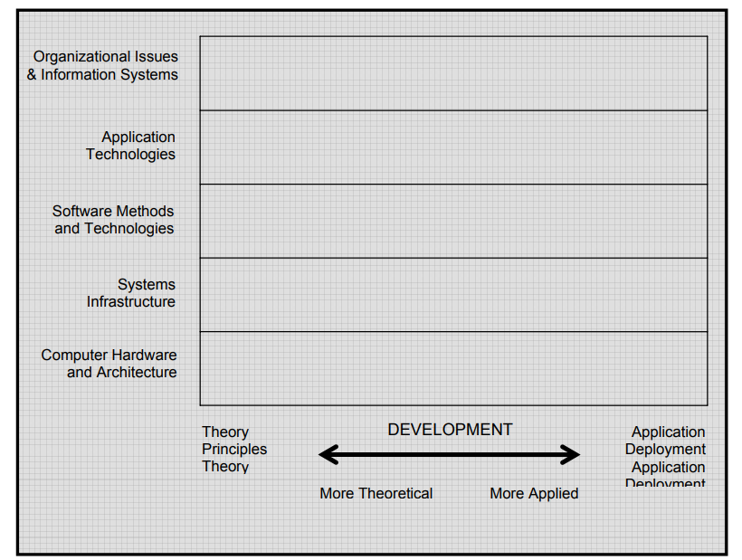

Slide 6
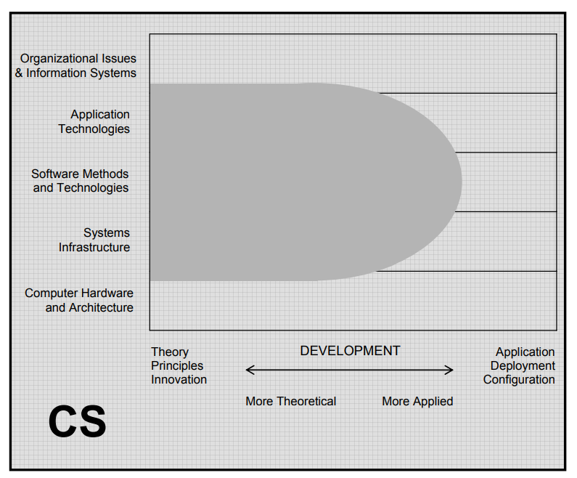

Slide 7
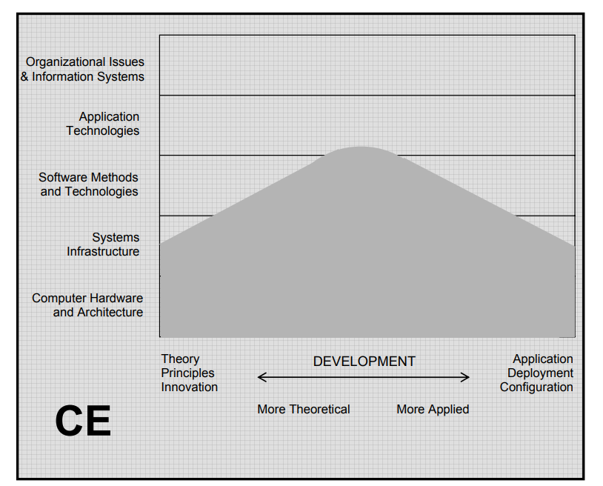

Slide 8
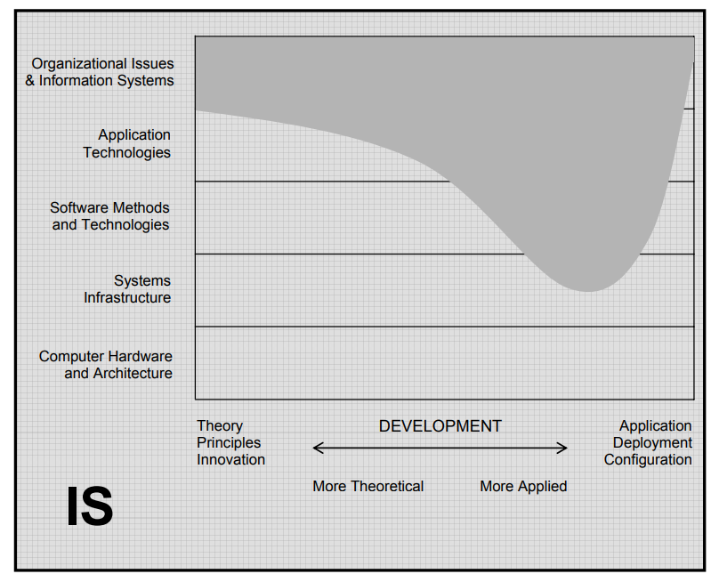

Slide 9
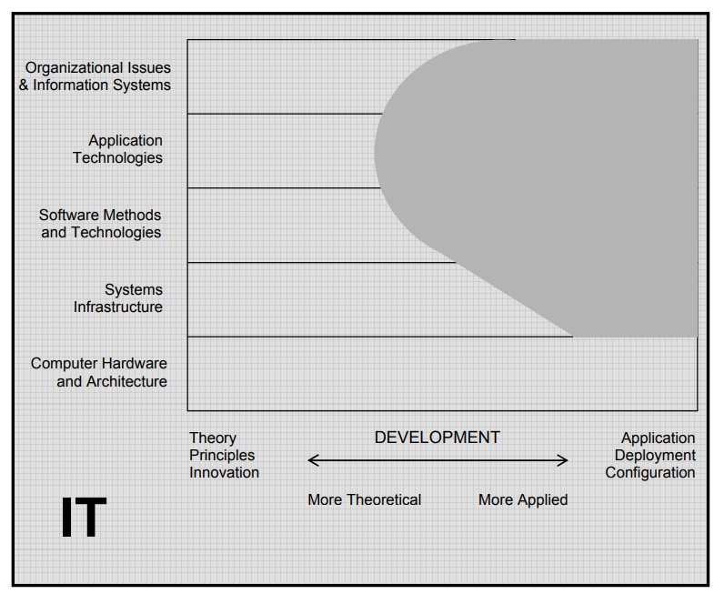

Slide 10
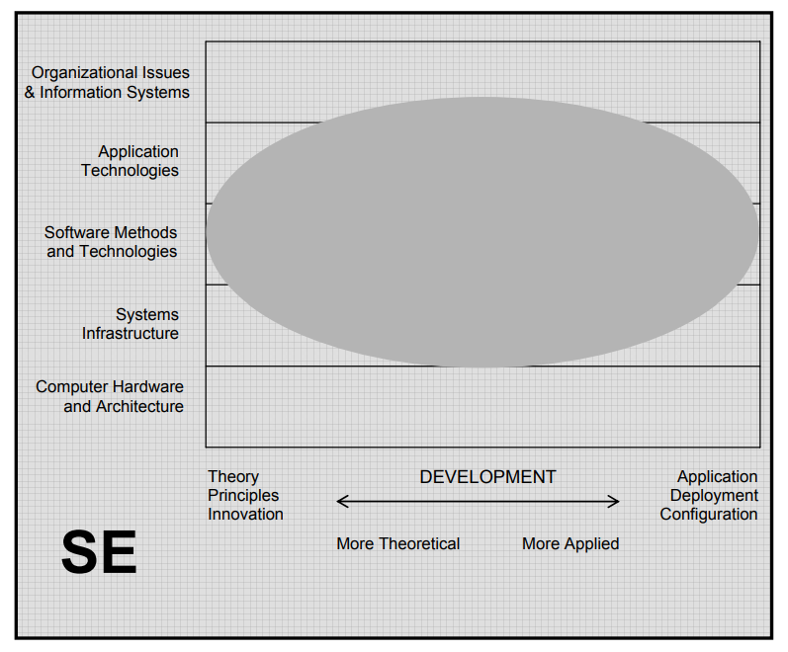

Slide 11
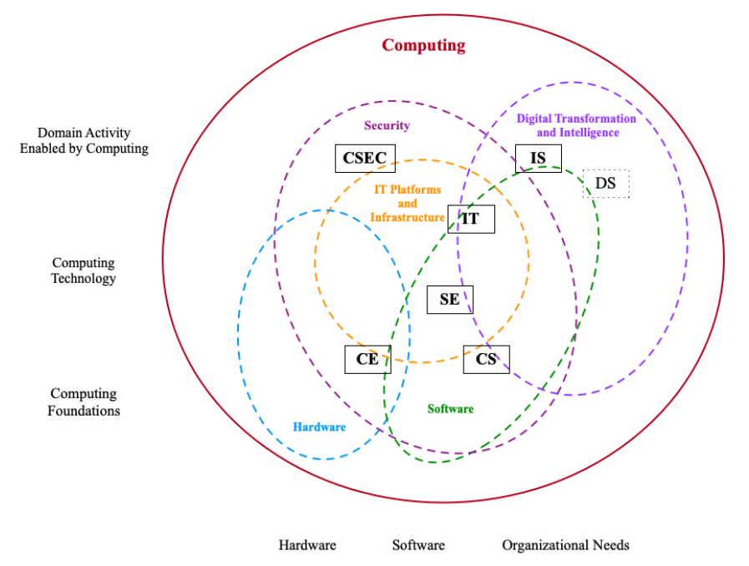
Landscape of Computing Education
ACM Computing Curricula 2020
CS : Computer Science
CE : Computer Engineering
IT : Information Technology
SE : Software Engineering
IT : Information Technology
IS : Information Systems
DS : Data Science
CSEC : Computer Security

Slide 12
Jamboard
Access jamboard :
S15: https://tinyurl.com/ccicomps15
S11b : https://tinyurl.com/ccicomps11b
Add pictures of what other fields use computers (use slide 3-5)
What other fields use computers?

Slide 13
Breakout Room
From your homework, go to your breakout rooms and discuss how to group the words.
As a group, combine your homework
Make a google slide and you’ll present it in class.
You have 10 minutes to put them together
Return to the main room when you’re done.
Or use the remaining time to get to know each other :)
If you have questions, go back to the main room.
Choose someone to present your work.

Slide 14
During class:
Announcements
Breakout rooms : I encourage you in using your video in breakout rooms to meet your classmates.
We’ll use your homework for a groupwork today which you will submit and present.
Turn off your audio/video unless you’re talking/presenting or in a breakout room. This will help with everyone’s video experience by conserving the bandwidth.
Raise your hand or type in the chat if you want to ask questions.
S15
No laboratory tomorrow
S11b
We have a lecture class on Monday, both AM and PM
Updated Consultation Hours: (see canvas)
M 7:00-9:15am
T 7:00-11:30am
To Access the jamboard :
S15: https://tinyurl.com/ccicomps15
S11b : https://tinyurl.com/ccicomps11b
Notes:
Note :
The homework was to group a bunch of words they put in the jamboard on words that they can think of when they think of the word computer.

Slide 15
Breakout Room
From what you’ve learned and from your homework, go to your breakout rooms again and discuss how you grouped and how you will group your work based on the different types of computing fields. Words can appear on multiple fields.
CS : Computer Science
CE : Computer Engineering
IT : Information Technology
SE : Software Engineering
IT : Information Technology
IS : Information Systems
DS : Data Science
CSEC : Computer Security

